Slide 1
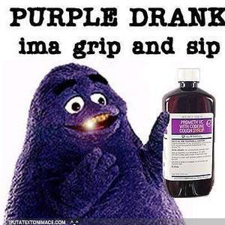
The Dangers of purple drank
By: Beatriz Thames and Donna-kaye Ennis

Slide 2
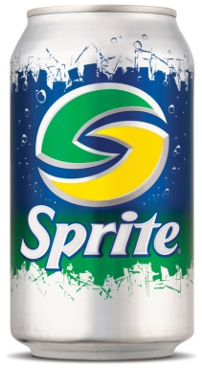
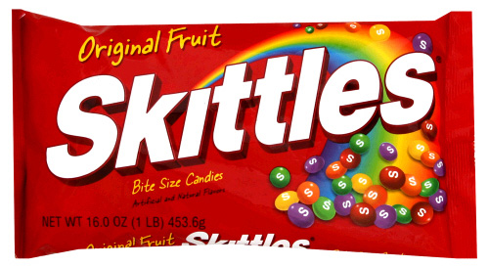
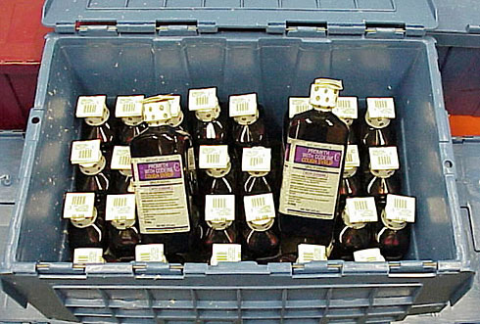
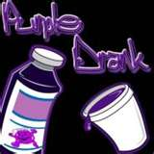
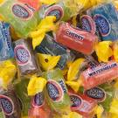
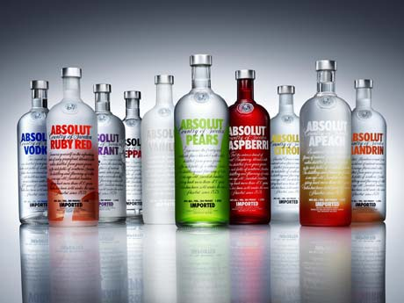
What is Purple Drank?
Purple Drank is a recreational drug that’s a mixture of cough syrup containing codeine and promethazine and a soda (typically Sprite) or alcoholic drink (vodka) that is added for flavoring. It’s called purple drank from the purplish hues of the medicine, but has been known to change to rainbow colors when Jolly ranchers or Skittles are added.

Slide 3
Common Street Names
Purple Oil
Sizzurp
Drank
Purple Tonic
Serbian Intestinal Scum Drizzank
Southern Lean
Texas Tea
Memphis Mud
Mrs. Dranklesworth
Derek’s Dookie Sauce
Tsikuni
Lean Syrup
P-Flav
Slip
Purple Sprite
Surp
Bazzigazzulp
PG Tips
Purp.

Slide 4

Type of Drug
What is an opiate? An opiate is a drug derived from the opium plant. The main opiates are…
morphine
codeine - can have a stronger or lesser effect depending on how it is extracted from the opium plant
heroin
thebaine
papaverine
The drugs help to produce a relaxing effect.

Slide 5

Short term Side Effects Include
Sense of euphoria
Drowsiness
Dry mouth
Dizziness
Confusion
Impaired motor skills and judgment

Slide 6
Long Term Side Effects Include
• psychological and physical dependence • Body as a whole- muscle spasticity • Respiratory- difficulty breathing, slow, shallow and labored breathing, stopped breathing (sometimes fatal within 2-4 hours) • Eyes, ears, nose and throat- pinpoint pupils • Gastrointestinal- constipation, spasms of the stomach and intestinal tract. • Heart and blood vessels- low blood pressure • Nervous system- drowsiness, disorientation, coma

Slide 7
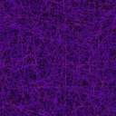
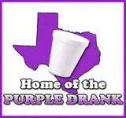

Origins
DJ Screw first popularized the purple drank and inspired a style of hip hop music called “chopped and screwed” (sounds are slowed down and slurred at some points to imitate the actual effects of getting high on purple drank). Underground Houston was where it became most popular but then spread to other southern states.

Slide 8
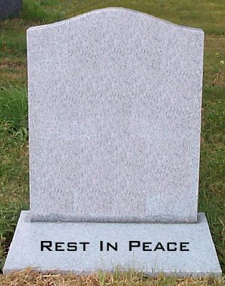
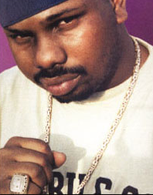
Origins (continued)
DJ Screw died of a suspected overdose of codeine and alcohol.
DJ Screw

Slide 9
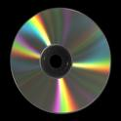
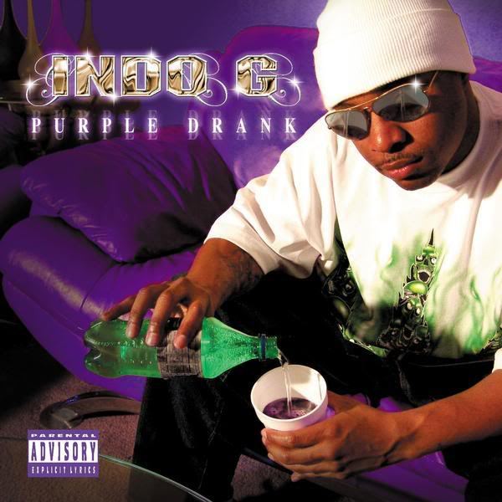
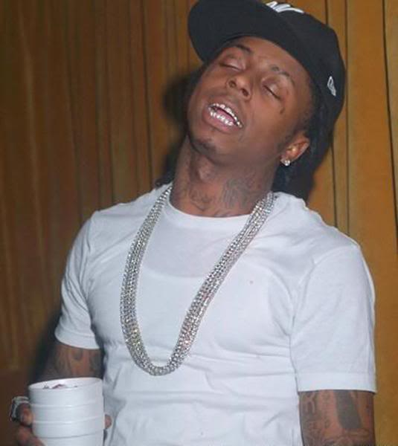
Origins(continued)
The following rappers have also made reference and introduced the drug to a nationwide audience
Lil’ Wayne
Lil’ Flip
Lil’ Wyte
Three Six Mafia
Project Pat
T-Pain
Chamillionaire
Big Moe
Slim Thug
Pat Cash
Z-Ro

Slide 10
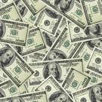
Statistics
In 2004, a survey found that 8.3% of secondary school students in Texas had taken codeine syrup to get high.
A pint of codeine promethazine cough syrup used to be about $20
16 oz used to be $120 to $125
Now a pint of codeine promethazine has gone up to $250 - $350.

Slide 11

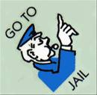
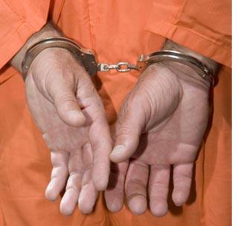
Legal Issues
San Diego Chargers player, Terrence Kiel, was arrested during practice for the possession and attempt to sell the drug on September of 2006.
Kiel was charged with two felony counts of transporting a controlled substance and three counts of possession for sale of a controlled substance.
Purple Drank is Illegal.

Slide 12

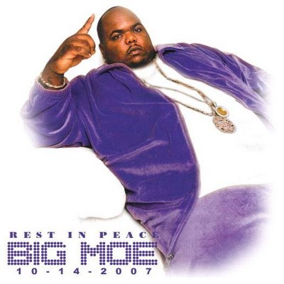
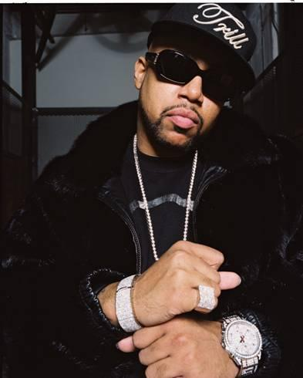
R.I.P.
BIG MOE- DIED IN 2007, AFTER A HEART ATTACK AND HAVING BEEN IN A COMA. THERE WAS SPECULATION THAT SIZZURP MAY HAVE LEAD TO HIS DEATH. HE WAS 33.
PIMP C- DIED IN 2007, FROM HEART FAILURE. IT WAS DETERMINED BY THE CORONER'S OFFICE THAT THE RESULT WAS AN OVERDOSE ON SIZZURP. HE WAS ALSO 33.

Slide 13
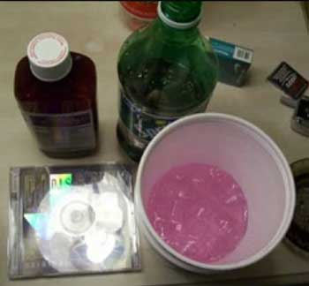
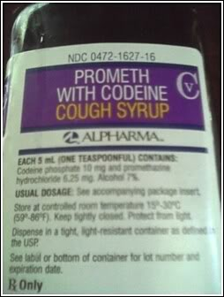
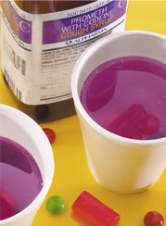
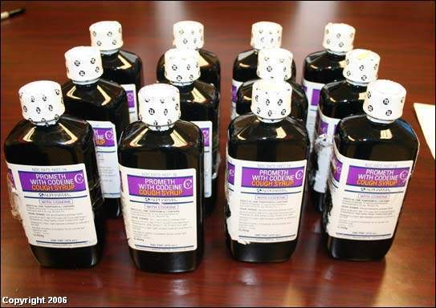
Pictures of the Drug

Slide 14
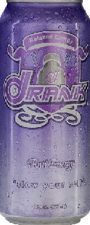
An Alternative
A reverse energy drink that legally relaxes you without the use of codeine cough syrup, soda, and jolly ranchers. With the use of melatonin, valerian root, and rose hips, the product claims to “slow your roll”.

Slide 15
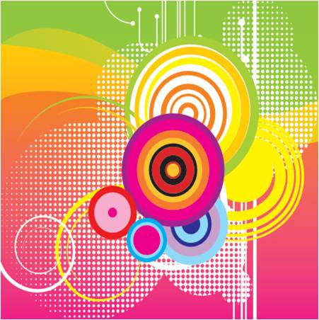
Sources
http://www.prairieview.net/Syrup.htm
http://www.barrypopik.com/index.php/new_york_city/entry/purple_drank/
http://www.addictionsearch.com/treatment_articles/article/opiate-addiction_35.html
http://www.wlox.com/Global/story.asp?s=8360136
http://www.barrypopik.com/index.php/new_york_city/entry/purple_drank/

